Slide 1
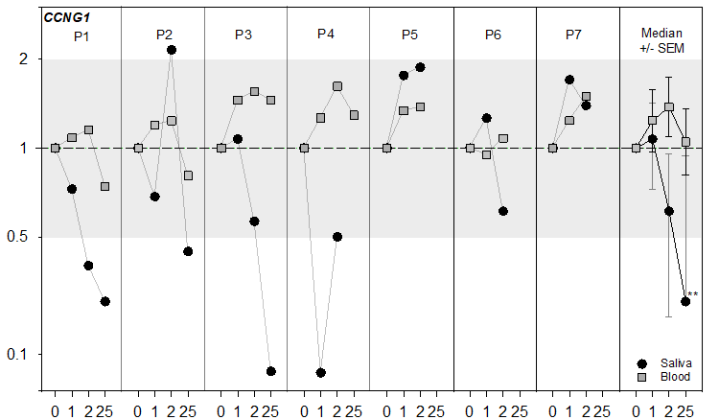
Supplemental figure 1 A
Ostheim et al.

Slide 2
Supplemental figure 1 B
Ostheim et al.

